Slide 1

IMDb Score Prediction
By
Keerthivasan
Godwin
Parkavi
Hariprasath

Slide 2
Abstract
IMDb, acronym for Internet Movie Database, is a website owned by Amazon.com where users can look for details about movies .
A commercial success movie not only entertains audience, but also enables film companies to gain tremendous profit. A lot of factors such as good directors, experienced actors are considerable for creating good movies. However, famous directors and actors can always bring an expected box-office income but cannot guarantee a highly rated IMDb score.
The goal of this research work is to predict the rating of a given movie using properly trained Machine Learning models and evaluate the goodness of the predictions.

Slide 3
Dataset Description
In this project, we take IMDB scores as response variable and focus on operating predictions by analysing the rest of variables in the movie_metadata .The dataset is from Kaggle website. It contains 28 variables for 5043 movies, spanning across 100 years in 66 countries. There are 2399 unique director names, and thousands of actors/actresses.
(https://www.kaggle.com/datasets/carolzhangdc/imdb-5000-movie-dataset)
1.Problem Statement
2.Data Mining
3.Data Cleaning
4.Data Exploration
5.Feature Engineering
6.Predictive Modelling

Slide 4
Problem Statement
Based on the massive movie information, it would be interesting to understand what are the important factors that make a movie more successful than others. So, we would like to analyse what kind of movies are more successful, in other words, get higher IMDB score. We also want to show the results of this analysis in an intuitive way by visualizing outcome using Python.
In this project, we take IMDB scores as response variable and focus on operating predictions by analysing the rest of variables in the movie_meta data. The results can help film companies to understand the secret of generating a commercial success movie.

Slide 5
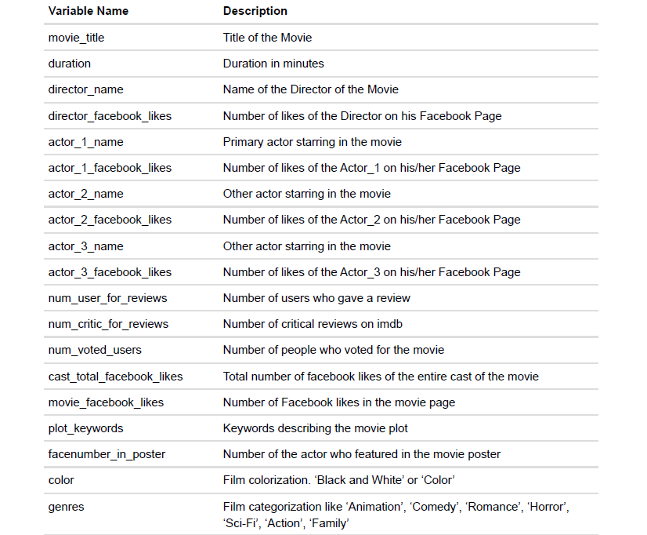
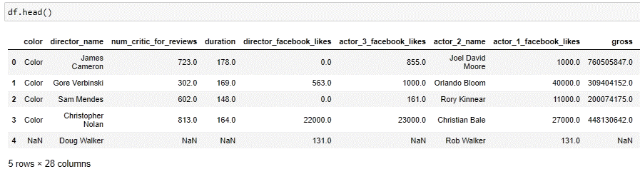
Data Mining
The process of extracting information to identify patterns, trends, and useful data that would allow the business to take the data-driven decision from huge sets of data is called Data Mining.

Slide 6
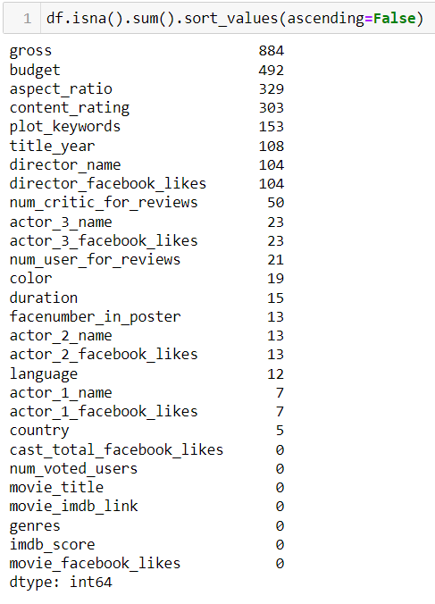
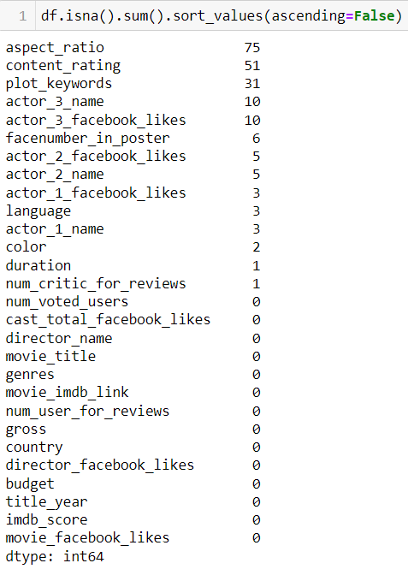
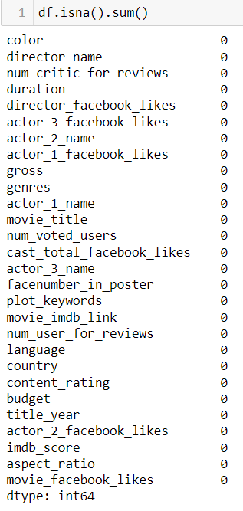
Data Cleaning
Nan (Null) Values
Drop Null Value Rows In (Gross , Budget) Drop the Missing Values

Slide 7


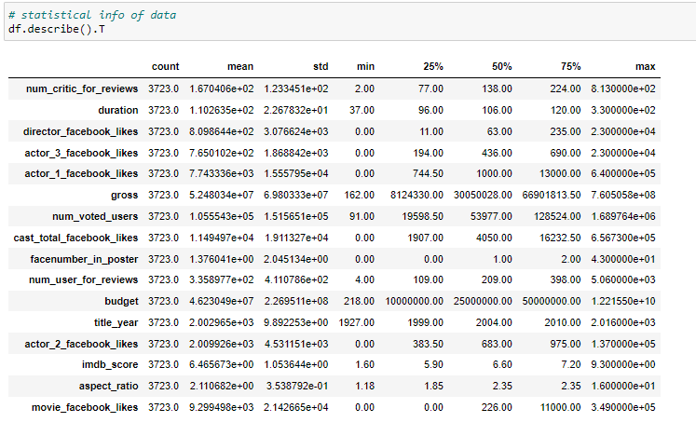
Remove Duplicates After removing duplicates from rows and columns
Statistical info of data

Slide 8
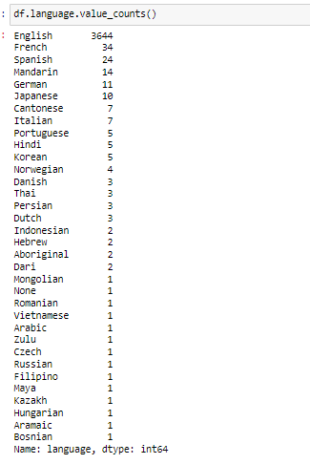
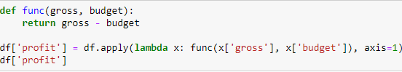
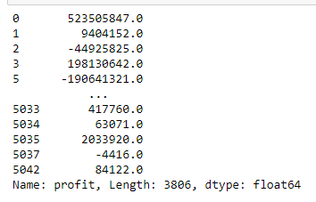
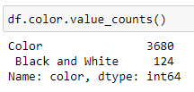
Add Columns
We have gross and budget information. So let’s add profit column for further analysis.
Remove columns
More than 96% movies are colored, which indicates that this predictor is nearly constant. Let’s remove this predictor
Is language an important factor for imdb score?
Over 95% movies are in English, which means this variable is nearly constant. Let’s
remove it.

Slide 9
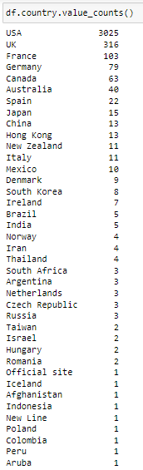
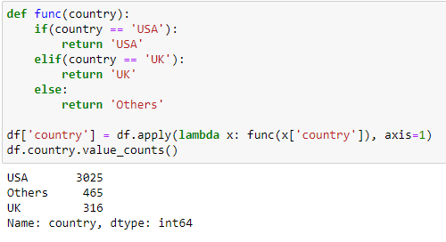
Add a Slide Title - 3
Let’s take a look at predictor country.
Around 79% movies are from USA, 8% from UK, 13% from other countries. So we group other countries together to make this categorical variable with less levels: USA, UK,Others.

Slide 10
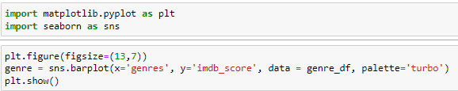
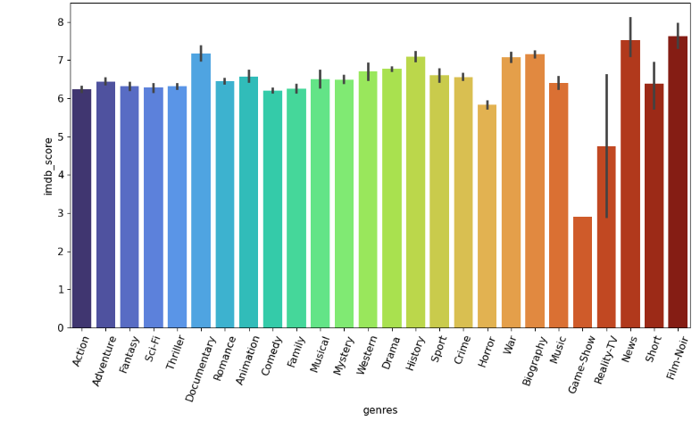
We plot a barplot for the score and genres to see if they are relative or not.
There isn’t much difference in the averages of imdb score related to different genres,almost
all the averages are in the same range of 6~8. So we think the predictor ”genres” can be removed because it’s not really related to the score.

Slide 11
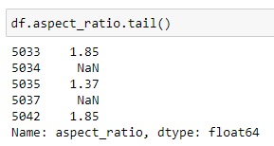
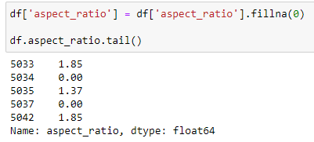
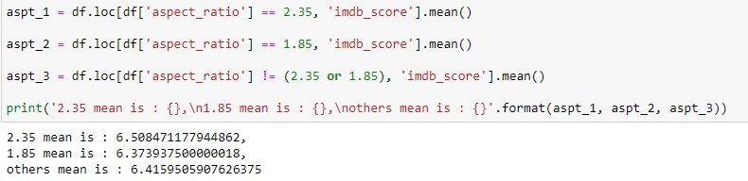
Analyze Aspect Ratio
In order to compute the mean of imdb score for different aspect_ratio, we need to replace NaN with 0 first.
The most common aspect ratios are 1.85 and 2.35.For analyzing purpose , we group other ratios together.
From the means of imdb score for different aspect ratios, we can see there is no significant difference, all the means fall in the range of 6.3~6.8. So, removing this variable won’t affect our following analysis.

Slide 12
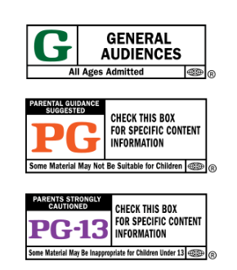
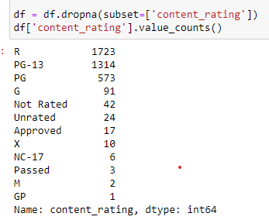

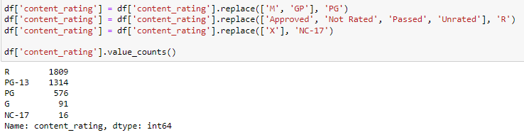
Sort Out Content Rating
According to the history of naming these different content ratings, we find M = GP = PG,X = NC-17. We want to replace M and GP with PG, replace X with NC-17, because these two are what we use nowadays.
We want to replace “Approved”, “Not Rated”, “Passed”, “Unrated” with the most common rating “R”.

Slide 13

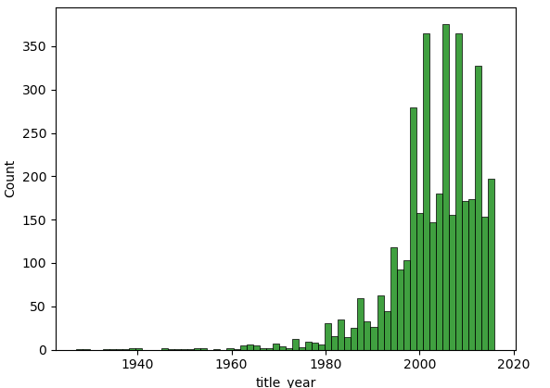
Data Visualization
Histogram of Movie Released
Movie production just exploded after year 1980. It could be due to advancement in technology and commercialisation of internet.
From the graph, we see there aren’t many records of movies released before 1980.It’s better to remove those records because they might not be representative.

Slide 14
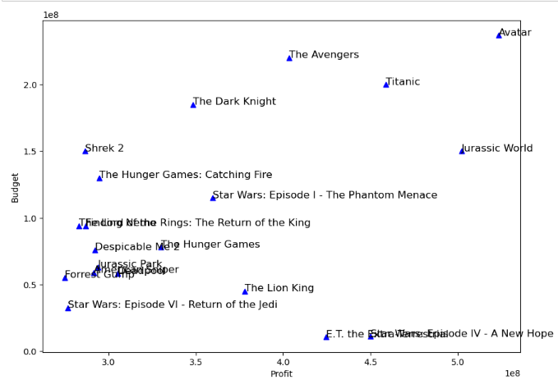
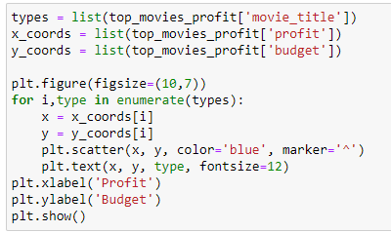
Top 20 movies based on its Profit
These are the top 20 movies based on the Profit earned (Gross - Budget). It can be inferred from this plot that high budget movies tend to earn more profit. The trend is almost linear, with profit increasing with the increase in budget

Slide 15
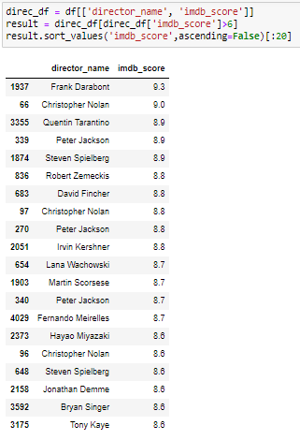
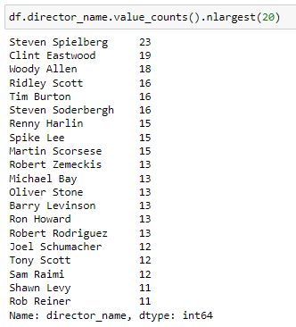

Slide 16
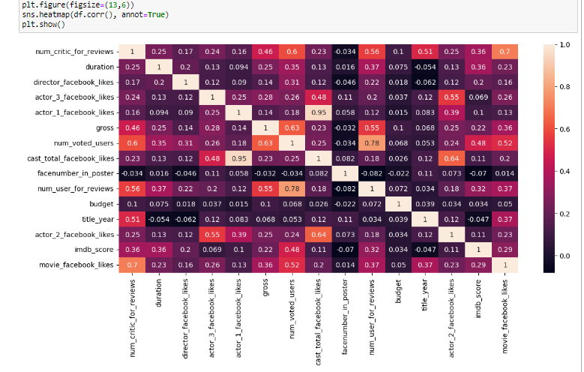
Add a Slide Title - 5
Based on the heatmap, we can see some high correlations (greater than 0.7) between predictors.According to the highest correlation value 0.95, we find actor_1_facebook_likes is highlycorrelated with the cast_total_facebook_likes, and both actor2 and actor3 are alsosomehow correlated to the total. So we want to modify them into two variables:actor_1_facebook_likes and other_actors_facebook_likes.There are high correlations among num_voted_users, num_user_for_reviews and num_critic_for_reviews. We want to keep num_voted_users and take the ratio of num_user_for_reviews and num_critic_for_reviews

Slide 17
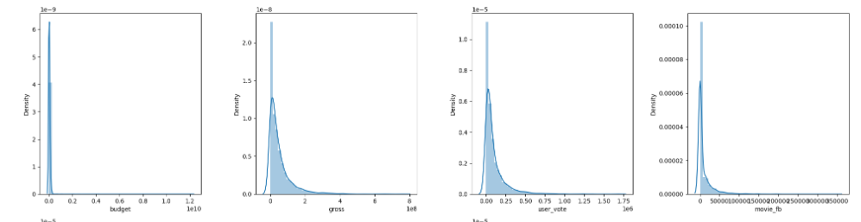
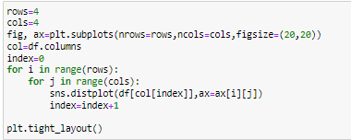
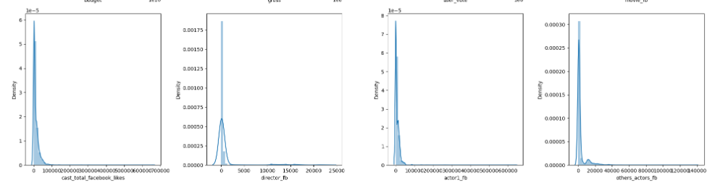
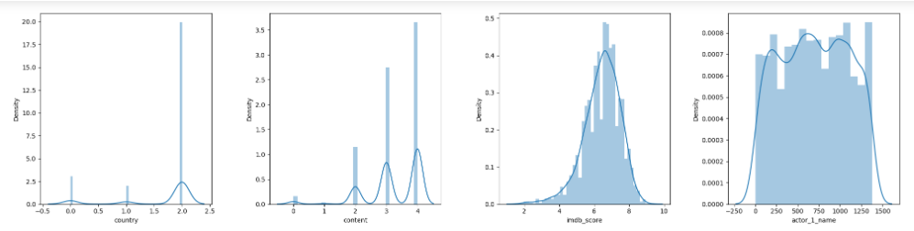

Slide 18

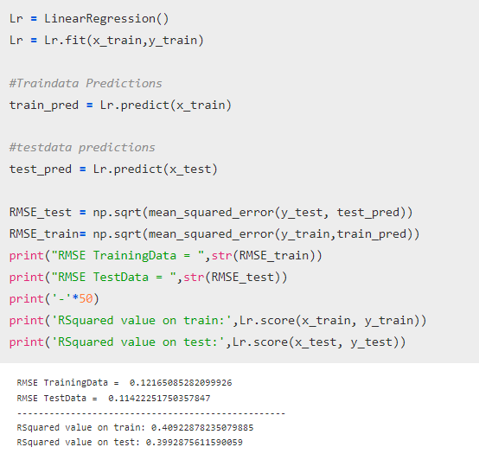
Machine Learning
Linear Regression

Slide 19
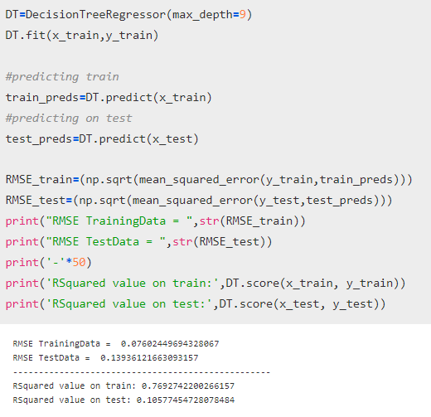
Decision Tree

Slide 20
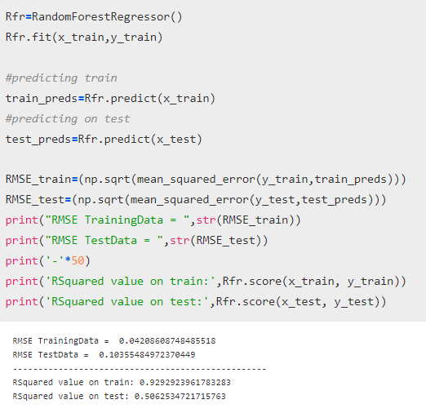
Random Forest Regressor

Slide 21
THANK YOU

